Slide 1
Mid-Summer Festival
Tanabata
Held in mid-summer on a date set
based on the Japanese lunar calendar

Slide 2
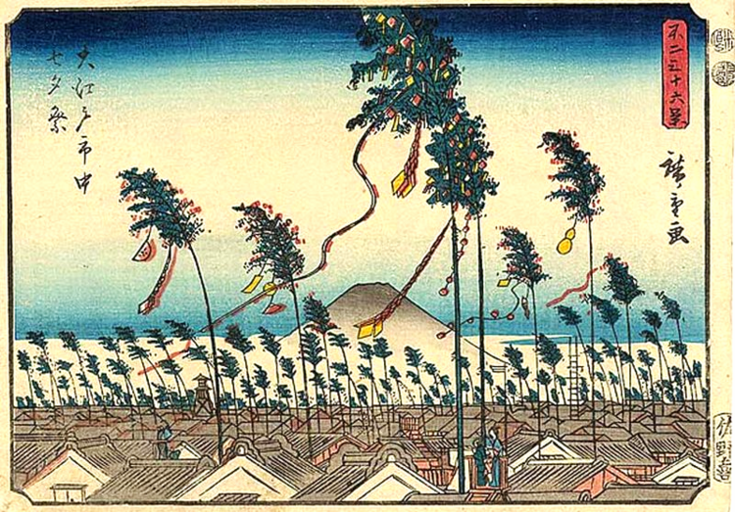
Tanabata festival in Edo (today’s Tokyo)
(By the Japanese artist, Hiroshige, 1852)

Slide 3
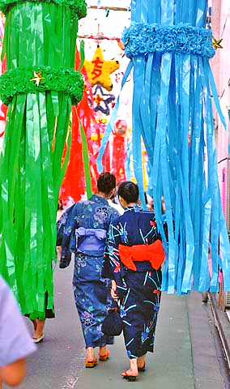
Tanabata festival in Tokyo

Slide 4
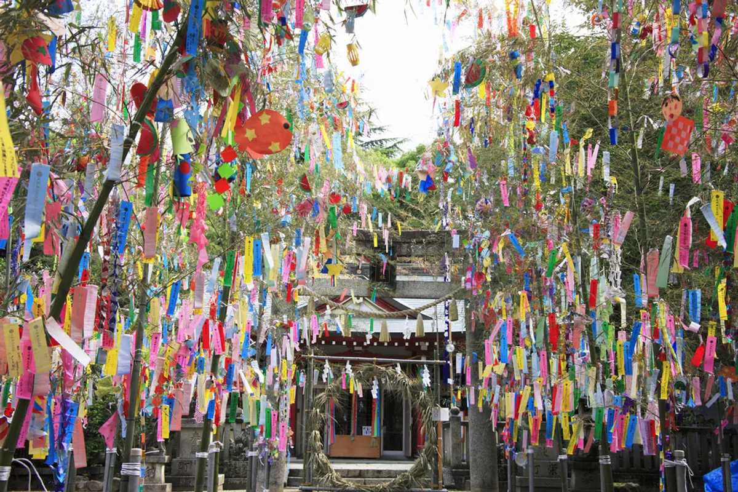
Tanabata festival decorations

Slide 5
Orihime and Hikoboshi

Slide 6
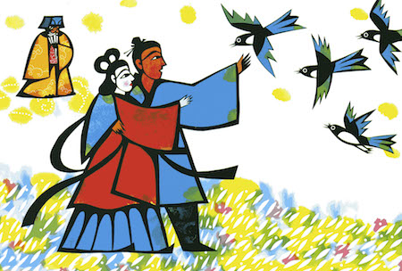
Orihime and Hikoboshi

