Slide 1
Moon Viewing Festival
Otsukimi
Held in Autumn based on the Japanese lunar calendar

Slide 2
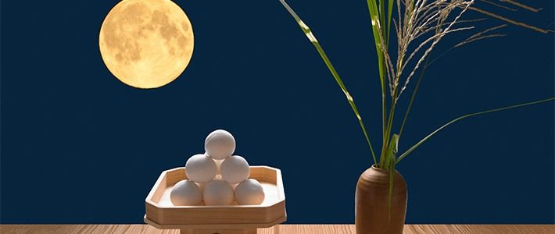
Tsukimi-dango, round rice dumplings

Slide 3
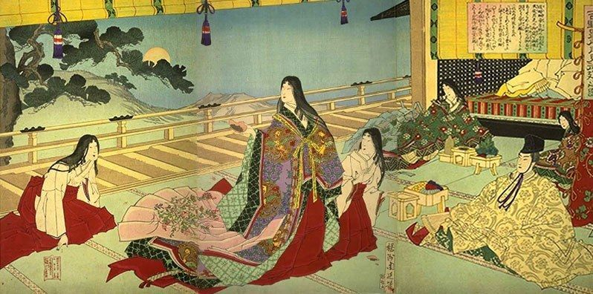
Moon viewing party at Yoshino Palace

Slide 4
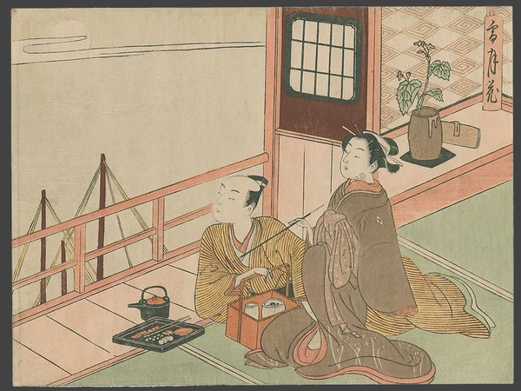
Torii Kiyonaga, A Couple Gazing at the Moon from Their Veranda.

Slide 5
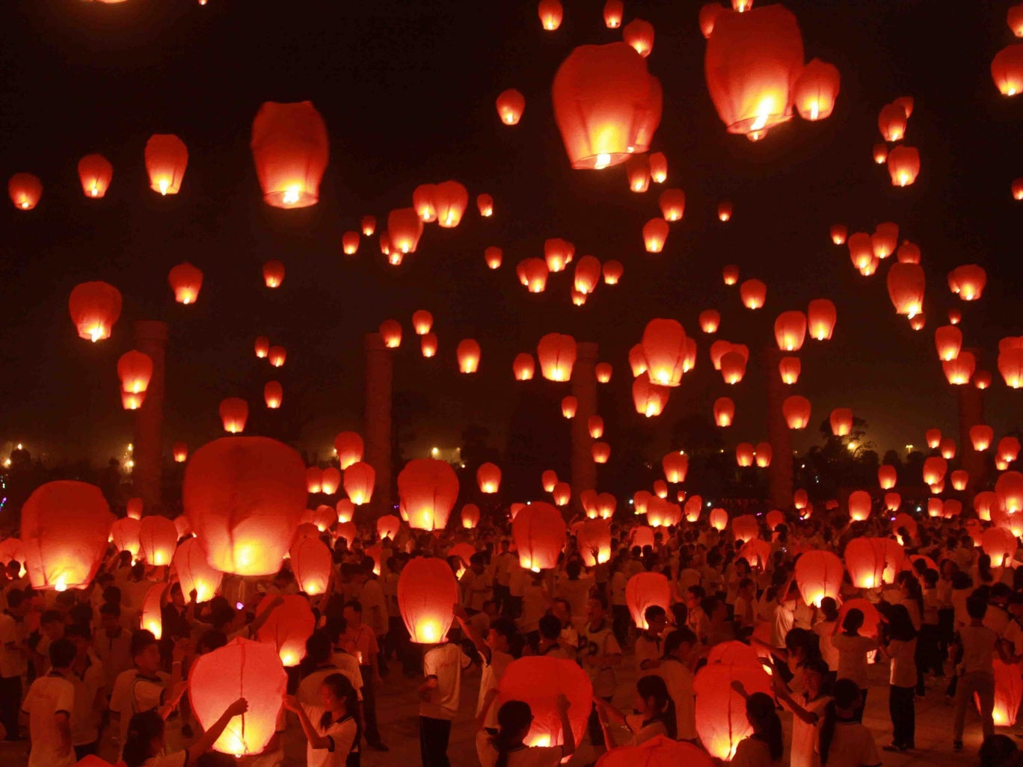
Moon Viewing Festival (Otsukimi) lanterns

Slide 6
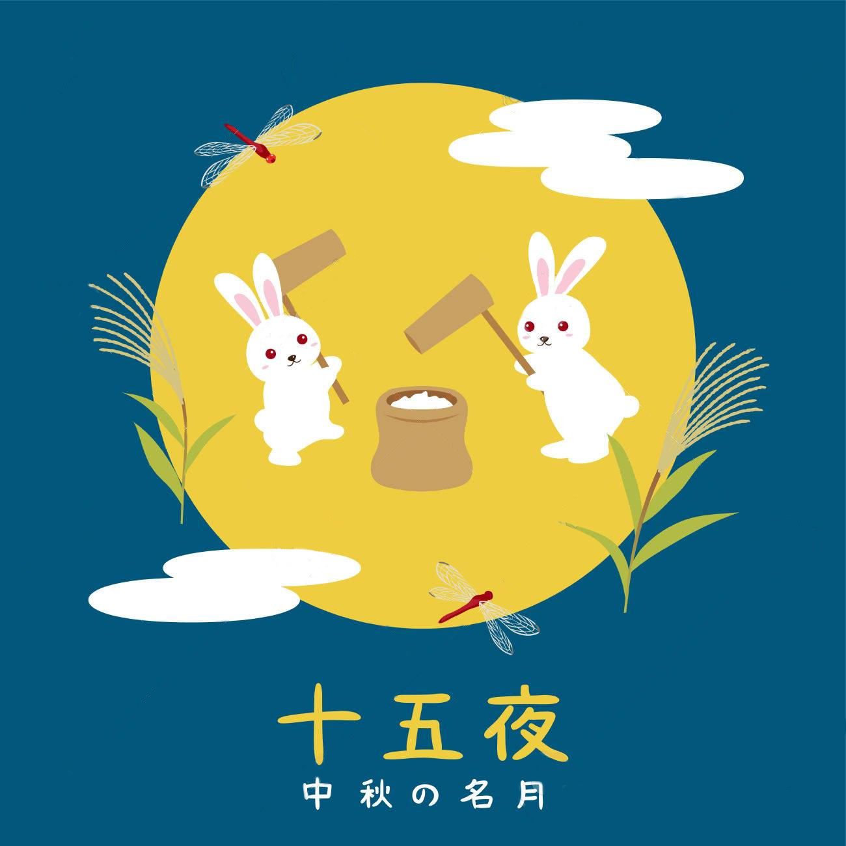
Moon Viewing Festival (Otsukimi)
Greeting card with rabbits pounding rice for rice cakes (mochi)

